Slide 1
SEEM 3460 Tutorial Assignment 2
wwxu@se.cuhk.edu.hk

Slide 2
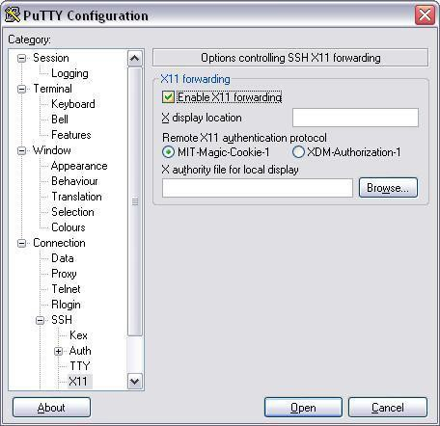
1. Environment Configuration
VcXsrv
https://sourceforge.net/projects/vcxsrv
VcXsrv is needed to handle GUI
If you need to run GUI programs.
run putty.exe
[Connection]-[SSH]-[X11]:
Enable X11 forwarding
[Session]:
Host Name: (e.g.) cuse81
Save for later use
Double click the saved session name to start SSH

Slide 3
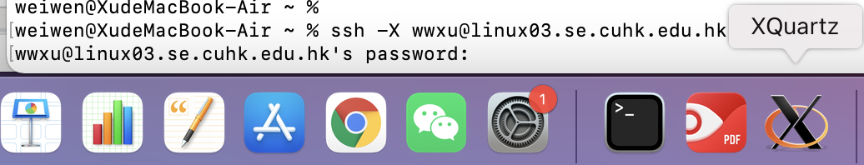
1. Environment Configuration
Xquartz (Mac user)
https://www.xquartz.org
ssh –X user@linux03.se.cuhk.edu.hk

Slide 4
1. Environment Configuration
To copy the material to your home directory
~: > cp -r ~seem3460/distribute/asgn2 ~/
Sample of Expected Program:
cd ~seem3460/distribute/asgn2_demo
./magic

Slide 5
2. Compile the assignment
To compile magic.c
Type “make magic”
To compile functest.c
Type “make functest”
Remember to save and compile(via make) after you edit the source code file
Otherwise your modification cannot be shown

Slide 6
4. To display text
display_text(str,x,y);
wait_keypress();
Use sprintf to write message
Example:
char text[1000] sprintf(text,’See you!’) display_text(text,10,10) wait_keypress()

Slide 7
5. To display image
For example, you want to show image Y.png
First, specify the position X
Second, call display_card(X,Y)
previously shown images will stay on GUI until display_card_clear is called
Example
display_card_clear()
display_card(0,1)
display_card(5,2)
display_card will not show space for position 1~4, so card in position 5 will closely follow card in position 0

Slide 8
Procedure of magic
1. choose a random card
2. generate 6 cards for first display
3. generate 5 cards for second display (plus the hidden card there will be 6 cards)
You may use the following equation to identify the card id:
4n + k, where 0 <= n <= 2 and 0 <= k <= 3
n represents the rank (0 is J, 1 is Q and 2 is K)
k represents the category (0 is heart, 1 is spade, 2 is diamond and 3 is club)

Slide 9
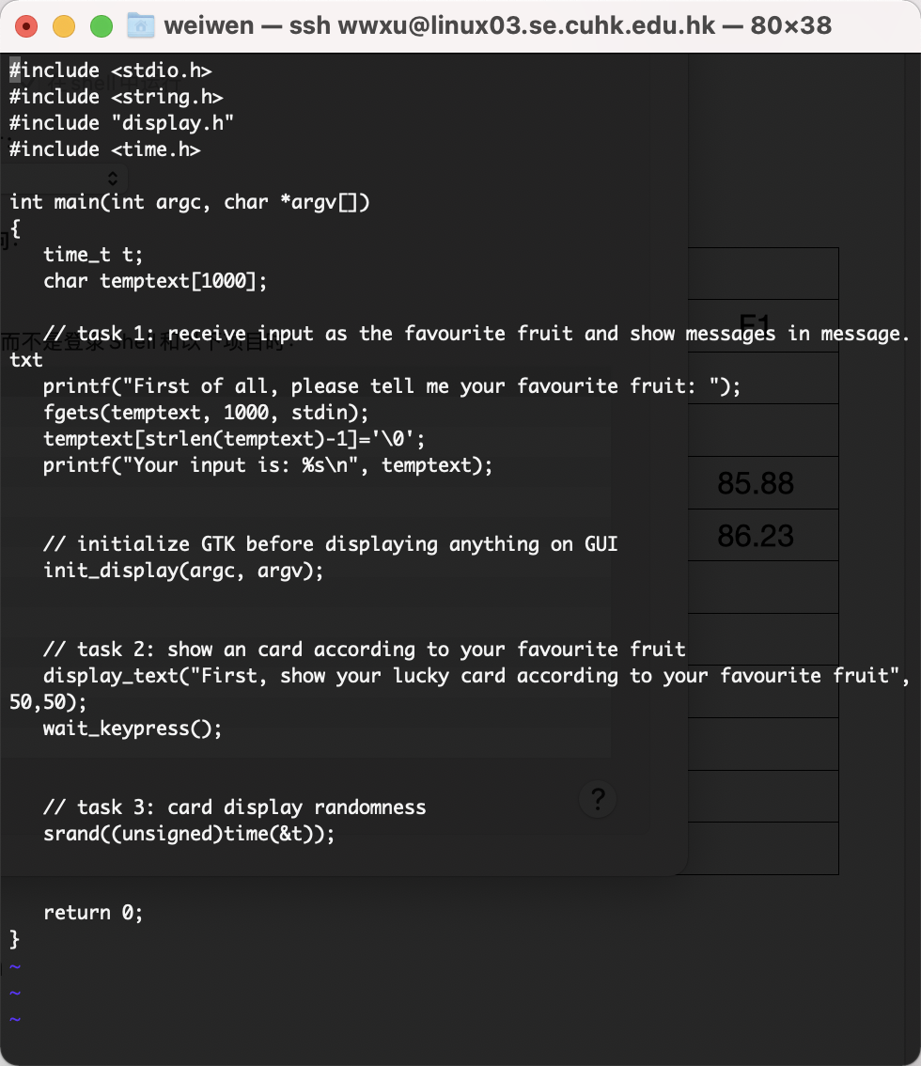
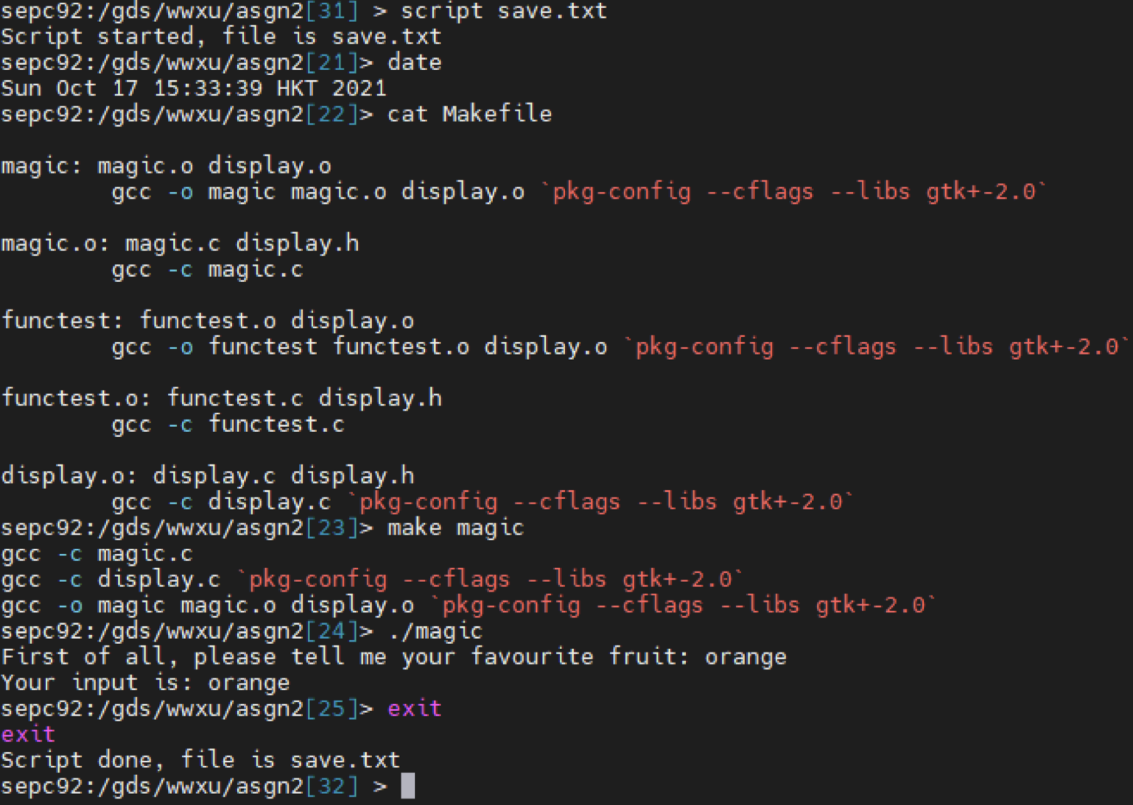
Submission
Linux Interaction Output
magic.c​

Slide 10

Important Information
Q&A web:
https://docs.google.com/document/d/ 1aRDeKBMyBxVub12rwdg7gK3Fxl5XEE6uqpL_ba4siFk/edit?usp=sharing
Last Year Grading Scheme:
Submit your assignment: 30
Your assignment can be compiled: 10
display messages + David: 20%
display lucky card: 10
display magic: 30

